Slide 1
Time Series Decomposition
Farhod Ibragimov, Mubashira Qari, Alexander Simon, Jackie Yee
DATA 624

Slide 2
Adjustments and Transformations
When decomposing a time series, it can be helpful to first transform or adjust the series to make the decomposition as simple as possible.

Slide 3
Calendar Adjustments
A bit of variation in seasonal data can be due to calendar effects, and this can be usually resolved by removing variation before further analysis.
Example: A manufacturing plant wants to analyze season patterns, but total monthly productions are distorted due to differing numbers of operating days.
Notes:
It is easy to remove this variation by computing average sales per operating day in each month, rather than total productions in the month. Then we effectively remove the calendar variation.

Slide 4
Population Adjustments
Data affected by population changes can be adjusted to give per-capita data. (Consider data per person, per thousand people, or per million people)
Example: You are studying the number of beds per thousand people.
Notes:
By removing the effects of population changes through considering the number of beds per thousand people, you can see if there’s a real increase in beds or the increases are due to population increase.
(It is possible for the total number of beds to increase, but the number of beds per thousand people to decrease. This occurs when the population is increasing faster than the number of hospital beds.)

Slide 5
Inflation Adjustments
The data that is affected by value of money is best adjusted before modeling.
Example: The average cost of a new house increased over a few decades because of inflation. A house that cost $100,000 in 2000, will cost more 30 years later.
Financial time series are typically adjusted in dollar values for a certain year.
X_{t} = y_{t} / z_{t} * z₂₀₀₀
z_{t} denotes price index and y_{t} denotes original house for t = year
Notes:
This allows us to compare the growth or decline of industries relative to a common price value.

Slide 6
Mathematical Transformations
For data showing variation that increases or decreases with the level of the series, a transformation can be useful.
Denote original transformation as y₁, …, y_{t} and the transformed observation w₁, …, w_{t} then w_{t} = log(y_{t})

Slide 7

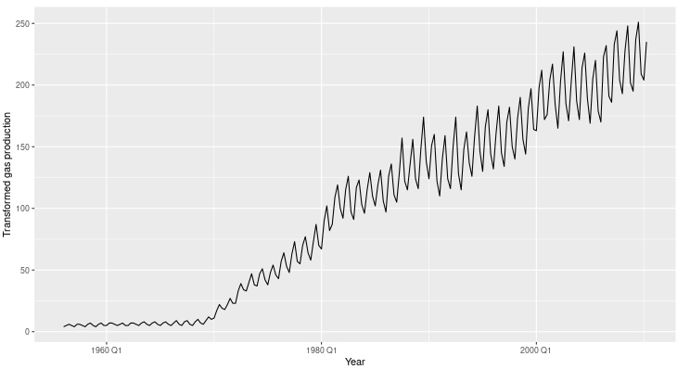
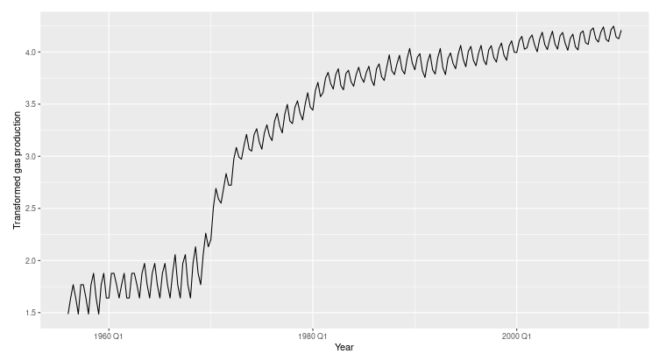
Modified Box-Cox Transformation
𝞴 = 1
𝞴 = .1
Notes:
A good value of λ is one which makes the size of the seasonal variation about the same across the whole series, as that makes the forecasting model simpler.

Slide 8
Time Series Components
Seasonal Component S_{t}
Data following a pattern with fixed frequency
Trend-cycle component T_{t}
Data following a increasing or decreasing pattern
Remainder Component R_{t}
Variations impacting individual variables

Slide 9
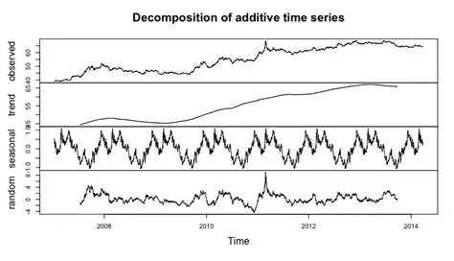
Additive Decomposition
Y_{t} = S_{t} + T_{t} + R_{t}
Notes:
The additive decomposition is the most appropriate if the magnitude of the seasonal fluctuations, or the variation around the trend-cycle, does not vary with the level of the time series.

Slide 10
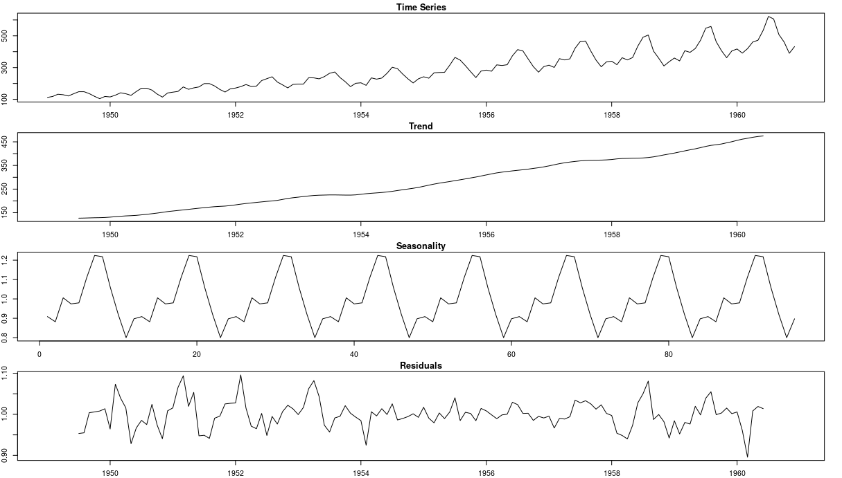
Multiplicative Decomposition
S_{t} * T_{t} * R_{t} = logS_{t} + logT_{t} + logR_{t}
Notes:
the variation in the seasonal pattern, or the variation around the trend-cycle, appears to be proportional to the level of the time series, then a multiplicative decomposition is more appropriate.

Slide 11
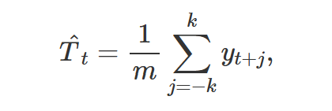
Moving averages: smoothing a trend-cycle
Definition: An m-MA is the average of a time series within k periods of a center point.
The Formula:
Purpose: To "smooth" the data. By averaging nearby observations, we cancel out random fluctuations (noise) to see the underlying trend.
The "Trade-off": Higher order (m) creates smoother trend, but causes loss of more data at the beginning and end of the series.

Slide 12
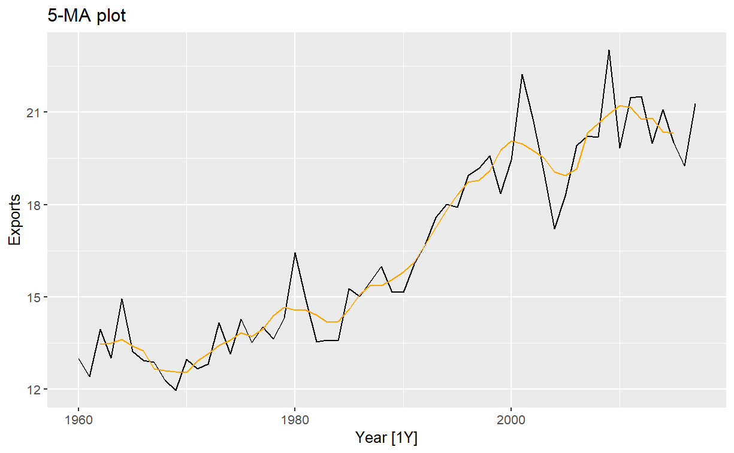
Moving averages: smoothing a trend-cycle

Slide 13
Moving averages: smoothing a trend-cycle
Pros
Extreme Simplicity: Very easy to calculate
Uniform Smoothing: It provides a consistent "lag" that is easy to understand—a 10-day MA is exactly the average of the last 10 days.
Effective for High Noise: If data is extremely wiggly with no clear direction, an SMA is great at flattening that noise completely.
Cons
The Outliers Effect: Because every point has equal weight, an outlier entering the window shifts the average, and then shifts it again when it leaves the window m days later, creating a "ghost" jump.
High Lag: SMAs are slow to respond to rapid changes in trend because the old data (at the edge of the window) carries as much weight as today’s data.

Slide 14


Centered Moving Averages (2 × m-MA)
The Symmetry Problem: Even-order averages (like a 4-MA) don't have a natural center; they fall between periods.
The Solution: Apply a second moving average (usually order 2) to "re-center" the data.
The Weighted Result: A 2 × 5-MA becomes a weighted 5-point average.
The weights sum must equal to 1.
Why it Works: In quarterly data, the first and last terms represent the same quarter in different years. Giving them "half-weight" ensures no single quarter overpowers the average.

Slide 15
Centered Moving Averages (2 × m-MA)
Pros
Reduced Lag: By placing more weight on the most recent (or central) observations, the trend line tracks the actual data more closely.
Superior Smoothing: WMAs result in much smoother curves that don't "wiggle" as much as simple ones when data enters the window.
Mathematical Neutralization: In 2 × m-MA, weighting is the only way to perfectly balance quarterly or monthly seasonality so that no single period overpowers the trend.
Cons
Complexity: Harder to explain to a non-technical audience (e.g., "Why is this quarter worth twice as much as that one?").
Weight Selection: Choosing the "correct" weights can be arbitrary unless you follow a specific standard (like classical decomposition).
Edge Data Sensitivity: If the weights are heavily front-loaded, a single outlier can cause a massive, misleading spike in the trend line.

Slide 16
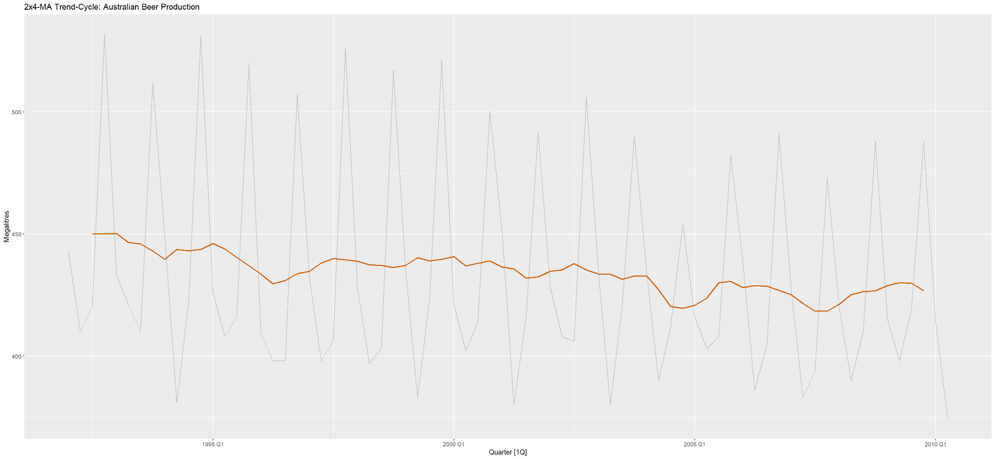
Centered Moving Averages (2 × m-MA)

Slide 17
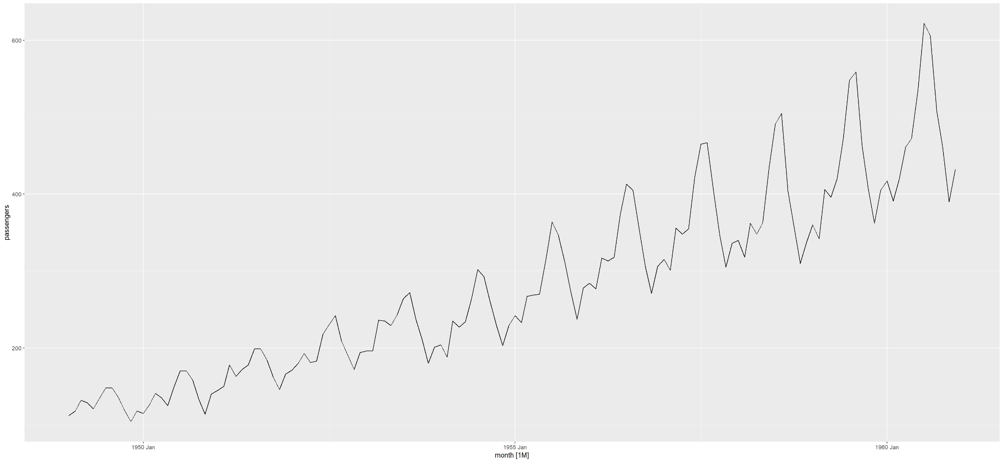
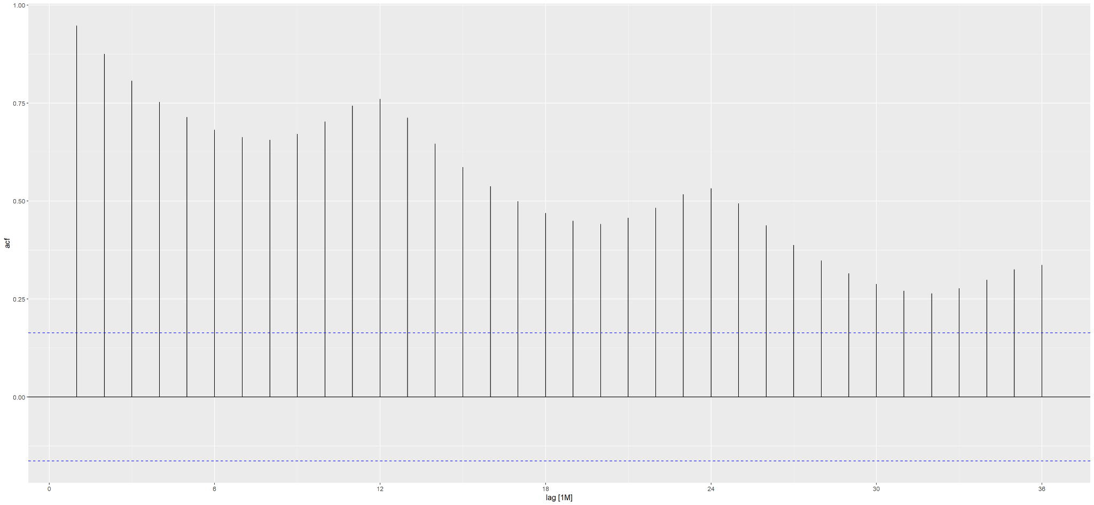
ACF
ACF (raw series)
Large positive autocorrelations at small lags
Slow decay across many lags
Indicates strong trend and seasonal dependence
Interpretation
Trend causes correlations to persist across many lags
Seasonality creates repeated dependence at fixed intervals
Noise and structure are mixed together
Implication
We cannot diagnose the true dependence structure while components are overlapping.

Slide 18
Additive and multiplicative decompositions
Additive decomposition
Multiplicative decomposition
Trend-cycle T
(2 x m-MA)
Trend-cycle T
(2 x m-MA)
Detrended seasons
y - T
Detrended seasons
y / T
Average of each detrended season S
Seasonal means by season
Average of each detrended season S
Remainder
R = y - T -S
Remainder
R = y / T / S

Slide 19
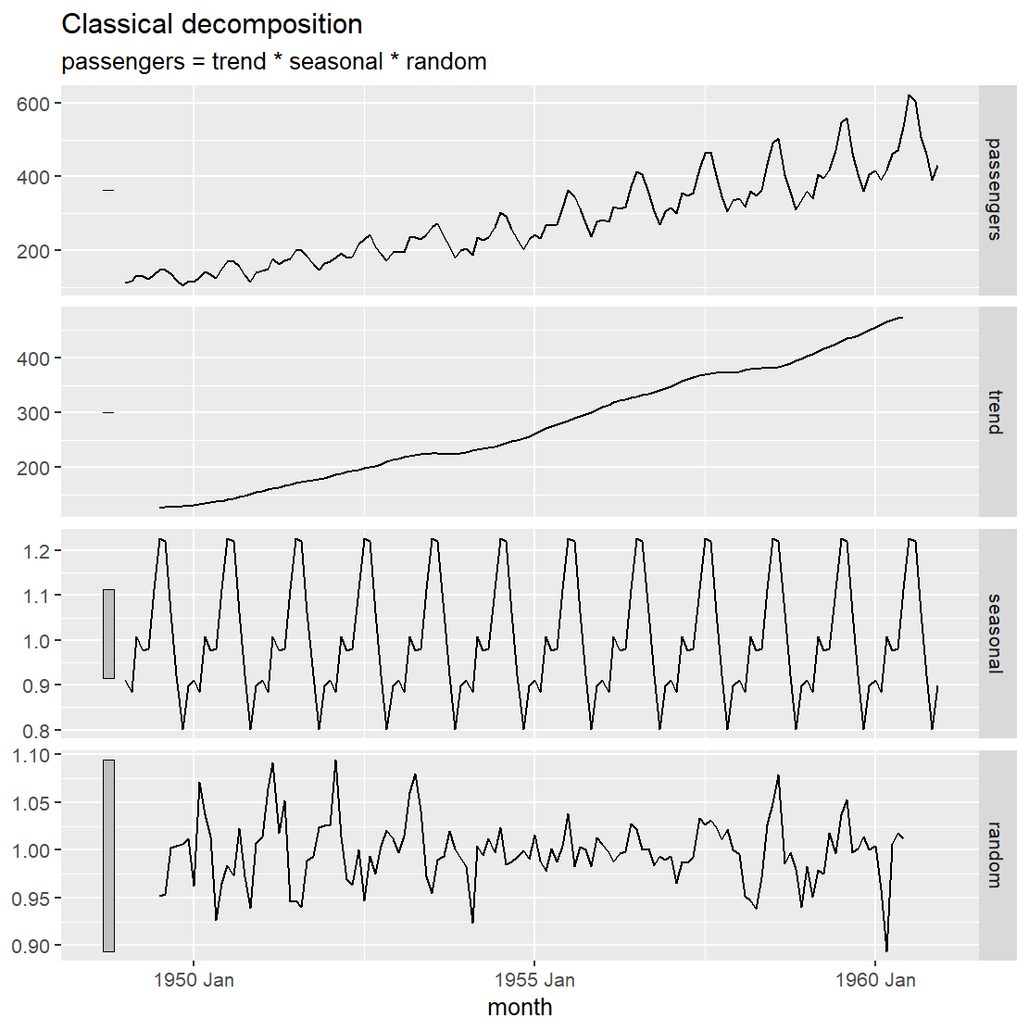
Classical Decomposition
What decomposition does
Moving averages remove trend
Seasonal averaging removes seasonal effects
Leaves a remainder component
ACF after decomposition
Trend in ACF is isolated in trend component
Seasonal spikes are isolated in seasonal component
Remainder ACF preferably ideally near zero

Slide 20
Pros and cons of Classical Decomposition
Classical Decomposition — Pros
Simple and easy to explain
Clearly separates trend, seasonality, and noise
Helps visualize structure in the data
Makes ACF patterns easier to interpret
Useful as an exploratory tool before modeling
Works well when seasonality is stable over time
Classical Decomposition — Cons
Assumes seasonality does not change over time
Trend is forced to be smooth, even if reality isn’t
Edge values are lost due to moving averages
Sensitive to outliers
Not a forecasting model by itself
Can give a false sense of structure if data is mostly noise

Slide 21
Methodologies Used by Official Statistical Agencies
Evolution of Time Series Decomposition
1920s: Development Time Series using Classical Decomposition methods.
1950s: The US Census Bureau created the more robust "Census II" approach.
This formed the foundation for the famous X-11 method and its successors (X-12-ARIMA and X-13-ARIMA).
1990s: The TRAMO/SEATS method was developed in Europe, offering a model-based alternative for seasonal adjustment.
STL Method: STL (Seasonal and Trend decomposition using Loess) was designed by Bell Labs.
Notes:
Speaker Notes: The Evolution of Decomposition
Global Impact: Decomposition is the backbone of global economics. Agencies like the Bureau of Labor Statistics use it to turn massive, messy datasets into clear signals that drive government policy.
The Agency Standard: For official seasonal adjustment, the world relies on two pillars: X-11 and SEATS. While they have different origins, they are often used together in a hybrid approach.
The Modern Tool: In our R code, we use the X_13ARIMA_SEATS function. This is the current industry standard that puts these professional agency-level tools directly into our hands.
A Century of Progress:
1920s: It began with Classical Decomposition, which was a great start but too rigid for complex data.
1950s: The US Census Bureau revolutionized the field with Census II, which evolved into the X-11 family we use today.
1990s: STL was developed at Bell Labs to handle more diverse data types, while SEATS emerged from Europe as a mathematically rigorous, model-based alternative.
The Goal: Whether it’s X-11 or SEATS, the goal is the same: strip away the seasonal 'noise' to reveal the true economic 'signal' policymakers need.

Slide 22
Methodologies Used by Official Statistical Agencies
X-11 Decomposition: Key Features
Algorithmic Iteration: Uses a multi-step process rather than a single formula to refine components.
Advanced Moving Averages: Employs sophisticated filters for smoother trend-cycle and seasonal isolation.
Evolving Seasonality: Allows seasonal patterns to change over time, unlike rigid classical methods.
Outlier Robustness: Automatically identifies and adjusts for extreme values and trading day effects.
Flexible Framework: Handles both additive and multiplicative data; easily implemented via the X11() function in fable.
Notes:
Speaker Notes: X-11 Decomposition
Introduction: Developed by the US Census Bureau, when they need to seasonally adjust data like unemployment rates or retail sales."
Algorithmic Iteration: Unlike classical decomposition which uses a single pass, X-11 is iterative. It goes back and forth—estimating the trend, then the seasonality, then refining the trend again—until the components are as clean as possible.
Advanced Moving Averages: It doesn't just use a simple moving average. It applies specialized filters that are better at handling the ends of the time series, which is usually where simple averages fail.
Evolving Seasonality: This is a major upgrade over classical methods. In the real world, seasonality isn't 'fixed.' For example, the peak of holiday shopping has shifted earlier in December over the last decade. X-11 can track that gradual change.
Outlier Robustness: One of its best features is that it’s hard to 'break.' It has built-in logic to spot outliers and handle 'trading day effects'—like if a month has five Sundays instead of four—so they don't ruin your trend line.
Flexible Framework: Finally, it's versatile. It supports both additive and multiplicative models. If you're using the fable package in R, you can call it easily using the X11() function, which is exactly what Hyndman discusses in Chapter 3.

Slide 23
Methodologies Used by Official Statistical Agencies
Disadvantages of X-11
No Formal Statistical Model: Based on an empirical algorithm rather than a mathematical model.
No Prediction Intervals: Does not provide measures of uncertainty for the components.
Restricted Frequency: Limited to monthly and quarterly data only.
No Support for Covariates: Cannot incorporate external variables (e.g., weather or strikes).
Black Box Nature: The iterative steps can be difficult to trace mathematically compared to simpler methods.
Notes:
Speaker Notes
No Formal Statistical Model: One of the main criticisms from statisticians is that X-11 is 'ad-hoc.' It’s a series of steps that work well in practice, but it doesn't have a solid underlying probability theory like an ARIMA model would.
No Prediction Intervals: Because there is no formal model, we don't get 'standard errors' for our trend or seasonal estimates. This means we can't easily say how confident we are in the decomposition—we just get a single point estimate.
Restricted Frequency: This is a big practical limitation for modern data science. If you’re working with daily sales or hourly web traffic, X-11 simply won't work; it’s hard-coded for the standard 4-quarter or 12-month fiscal cycles.
No Support for Covariates: X-11 is strictly univariate. It only looks at the history of the series itself. If you know that a specific promotion or a holiday like Easter (which moves dates) impacted your numbers, X-11 has a hard time 'learning' that from an external data source.
Black Box Nature: Because it is so iterative and involves many 'if-then' rules for handling outliers and filters, it can be hard to explain exactly why a certain data point was smoothed a certain way, unlike a transparent regression-based decomposition.

Slide 24
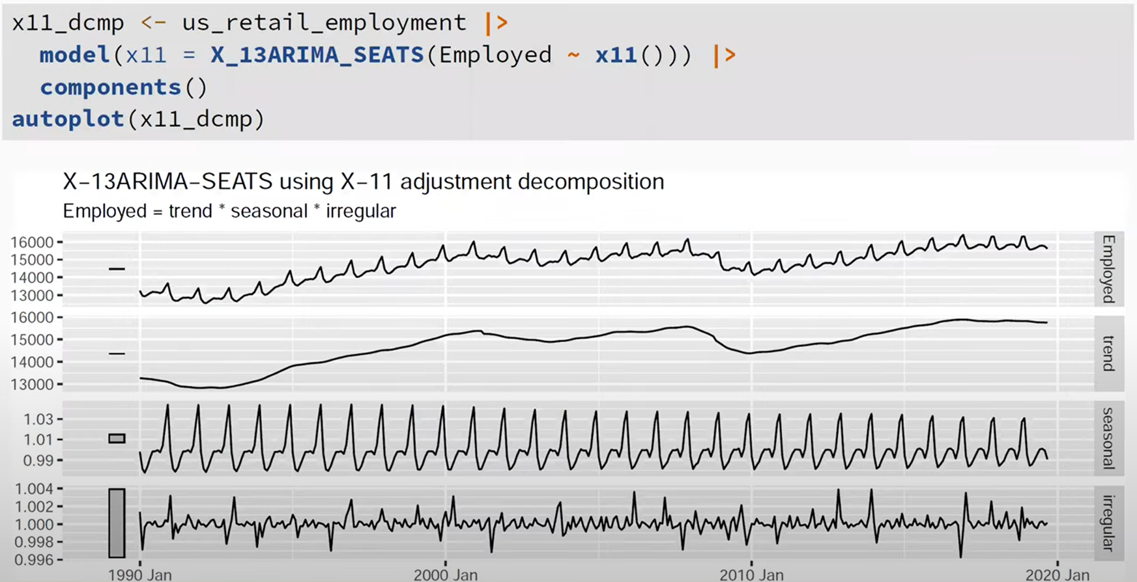
Methodologies Used by Official Statistical Agencies
Decomposition of Total US Retail Employment using X-11
Notes:
Interpreting the X-11 Decomposition
Data (Top chart): This is the original time series of US retail employment. You’ll notice a clear upward trend but with very sharp, regular spikes and dips occurring every year.
Trend (Second Chart): The X-11 method has smoothed out the seasonal "noise." This line shows the long-term direction of retail employment, revealing economic growth periods or recessions (like the 2008 crash or 2020 dip) more clearly than the raw data.
Seasonal (Third Chart): This isolates the "holiday effect." In retail, you’ll see a massive peak every December followed by a January drop. Because this is X-11, look closely at the peaks; you might notice they aren't identical every year, as the model allows this pattern to evolve over time.
Remainder (Bottom Chart): This is what’s left after removing the trend and seasonality. It represents "random noise" or "shocks." If there are large spikes here, it indicates unusual events like a strike or a specific economic shock that the seasonal and trend components couldn't explain.
Conclusion:
What the "ARIMA" part does, it "pre-adjusts" the data by forecasting the ends of the series to make the decomposition more accurate.
The primary goal of using X-11 here is Seasonal Adjustment. By subtracting the "Seasonal" panel from the "Data" panel, economists get the "Seasonally Adjusted" figure, which tells them if employment is actually growing or if the increase is just the typical holiday hiring surge.

Slide 25
Methodologies Used by Official Statistical Agencies
Advantages of SEATS Decomposition
Model-Based Approach: Built on a formal statistical foundation (ARIMA models).
Statistical Rigor: Provides theoretically sound components with calculated uncertainties.
Prediction Intervals: Allows for the calculation of intervals for the trend and seasonal components.
Sophisticated Filtering: Uses the specific characteristics of the data to determine the best filters.
Modern Standard: Works seamlessly within the X-13ARIMA-SEATS framework used by global agencies.
Notes:
Speaker Notes
Think of SEATS as the more 'academic' cousin of X-11. While X-11 uses a series of clever moving averages, SEATS uses the power of ARIMA models to extract components."
Model-Based Approach: While X-11 is essentially a smart set of 'rules of thumb' or an algorithm, SEATS is model-based. It uses ARIMA models to represent the different parts of the data. This moves us from 'empirical guessing' to 'statistical estimation.
Statistical Rigor: Because it’s based on formal models, every part of the decomposition has a mathematical justification. We aren't just smoothing the line because an algorithm said so; we are doing it because the underlying math of the time series suggests that specific structure.
Prediction Intervals: This is a huge win over X-11. Because SEATS is statistical, it can produce prediction intervals. This means we can actually quantify how much 'uncertainty' is in our trend or our seasonal estimate, which is vital for risk assessment.
Sophisticated Filtering: SEATS is 'tailor-made' for your specific data. Instead of using a standard set of filters for every series, it analyzes the data's properties first and then constructs the optimal filter to extract the trend and seasonality.
Modern Standard: Today, you don’t really have to choose between X-11 and SEATS. Modern software, like the X_13ARIMA_SEATS() function we use in R, allows these methods to work together to give us the most accurate seasonal adjustment possible.

Slide 26
Methodologies Used by Official Statistical Agencies
Disadvantages of SEATS
Complexity: Requires advanced knowledge of ARIMA models to interpret.
Rigid Frequency: Limited strictly to monthly and quarterly data.
Single Seasonality: Cannot handle multiple seasonal patterns (e.g., daily + weekly).
Model Dependent: Decomposition quality relies entirely on the initial ARIMA model fit.
"Black Box" Feel: Harder to explain to non-technical audiences than simple averages.
Notes:
Speaker Notes
Complexity: Unlike simple moving averages, SEATS is mathematically dense. If you aren't comfortable with ARIMA modeling, the underlying mechanics can be difficult to troubleshoot.
Rigid Frequency: It’s a legacy tool for economists. If your data is daily or hourly, SEATS simply won't work—it’s built for standard 4 and 12-period cycles.
Single Seasonality: It struggles with 'nested' patterns. For example, it can't simultaneously track a 'Friday surge' and a 'December surge' in the same dataset.
Model Dependent: The output is only as good as the model. If you pick the wrong ARIMA specification at the start, your trend and seasonal lines will be misleading.
"Black Box" Feel: It’s much easier to explain a '12-month average' than 'signal extraction via ARIMA partitioning.

Slide 27
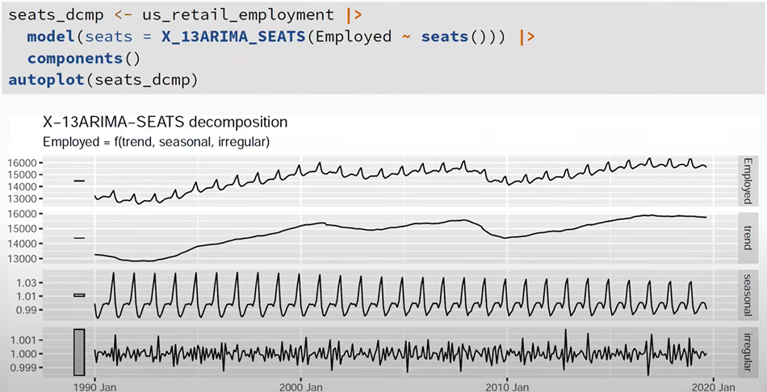
Methodologies Used by Official Statistical Agencies
Decomposition of Total US Retail Employment using SEATS
Notes:
Speaker Notes: Interpreting the SEATS Chart
Overall Layout: Like X-11, this autoplot gives us four panels: the original data, the trend-cycle, the seasonal component, and the remainder. While it looks similar to the X-11 output, these lines are derived from a formal ARIMA model.
The Trend-Cycle (chart 2): Notice how smooth this line is. Because SEATS uses model-based filters tailored specifically to this retail data, it’s exceptionally good at identifying the underlying economic direction, even during volatile periods like the 2008 recession.
The Seasonal Component (Chart 3): This is the 'Seasonal Extraction.' Because it is model-based, SEATS is very precise at identifying the holiday peaks. If you look closely at the scale, you can see exactly how many hundreds of thousands of jobs are attributed purely to the time of year.
The Remainder (Chart 4): This is our 'check' for model quality. We want this to look like random noise. If we saw patterns here, it would suggest our ARIMA model didn't fully capture the structure of the retail employment data.
Key Takeaway: The main difference here is that if we needed to, we could calculate prediction intervals for these lines because they are based on a statistical model, not just an iterative algorithm.

Slide 28
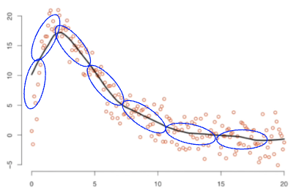
Seasonal and Trend Decomposition Using Loess (STL)
Versatile decomposition method
Captures short- and long-term variations
Handles complex patterns
Iteratively applies Loess
Loess = Locally-Weighted Scatterplot Smoothing
Nonparametric regression method that fits curves to localized subsets of data
Image source: Lowess and Loess, Clearly Explained!!! www.youtube.com/watch?v=Vf7oJ6z2LCc
Notes:
Two loops – inner + outer
Inner loop calculates seasonal and trend components
Seasonal smoothing -> de-seasonalized -> Trend smoothing
Outer loop computes robustness weights, which are used in the next inner loop

Slide 29
Advantages and Disadvantages of STL
Advantages
Handles any type of seasonality
Highly flexible (eg, user can define seasonal component, smoothness)
Handles missing values
Robust to outliers
Disadvantages
Does not handle trading day or calendar variations
Mainly additive decomposition
Notes:
A multiplicative decomposition can be obtained by first taking logs of the data, then back-transforming the components

Slide 30
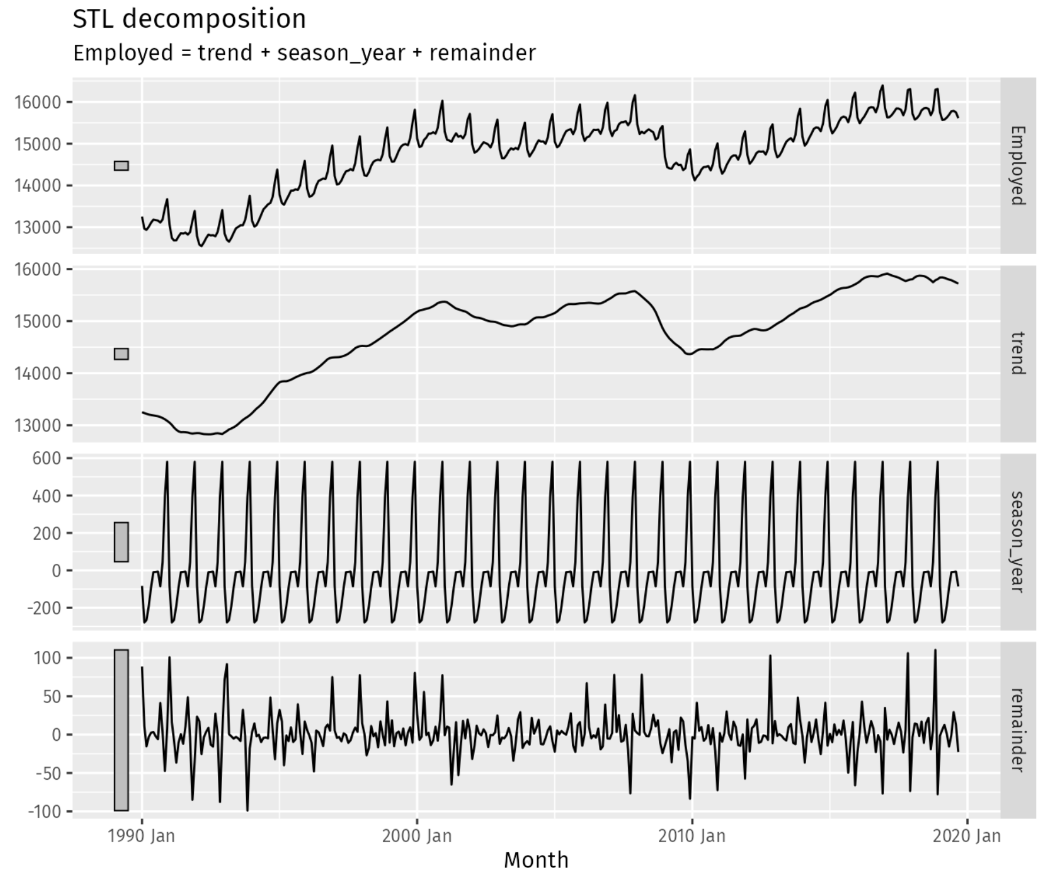
STL Example
us_retail_employment |>
model(STL(Employed ~
trend(window = 7) +
season(window = "periodic"),
robust = TRUE)) |>
components() |>
autoplot()
Trend and season window sizes should be odd numbers
robust=TRUE makes Loess smoothing less sensitive to outliers
Notes:
Trend window size is the number of consecutive observations to be used when estimating the trend-cycle
Season window size is the number of consecutive years to be used in estimating each value in the seasonal component
Parameters need to be odd; smaller values result in flatter curve

Slide 31
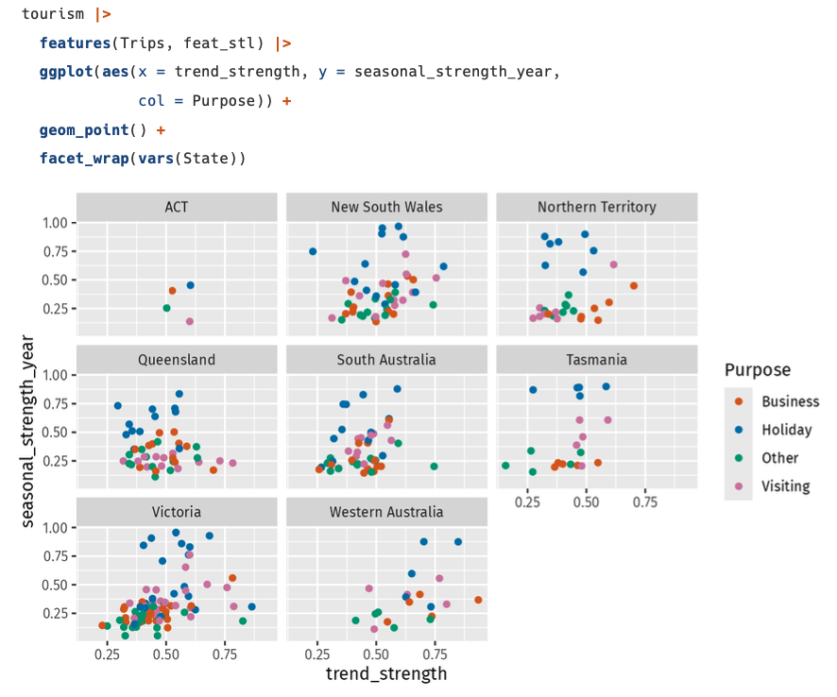


STL Features
Strength of trend
Strength of seasonality
R_{t}, remainder component; S_{t}, seasonal component; T_{t}, smoothed trend component; var, variance.

Slide 32
References
Hyndman RJ & Athanasopoulos G. (2021). Forecasting: Principles and Practice, 3rd edition
Cleveland RB et al. STL: A seasonal-trend decomposition procedure based on Loess. Journal of Official Statistics. 1990;6:3-73.

